Slide 1
Measuring TDD
Test Coverage, Compliance and Complexity

Slide 2
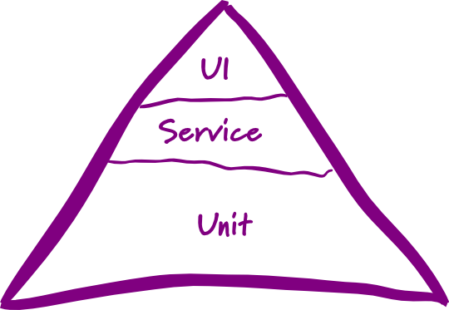
Mike Cohn’s Test Pyramid

Slide 3
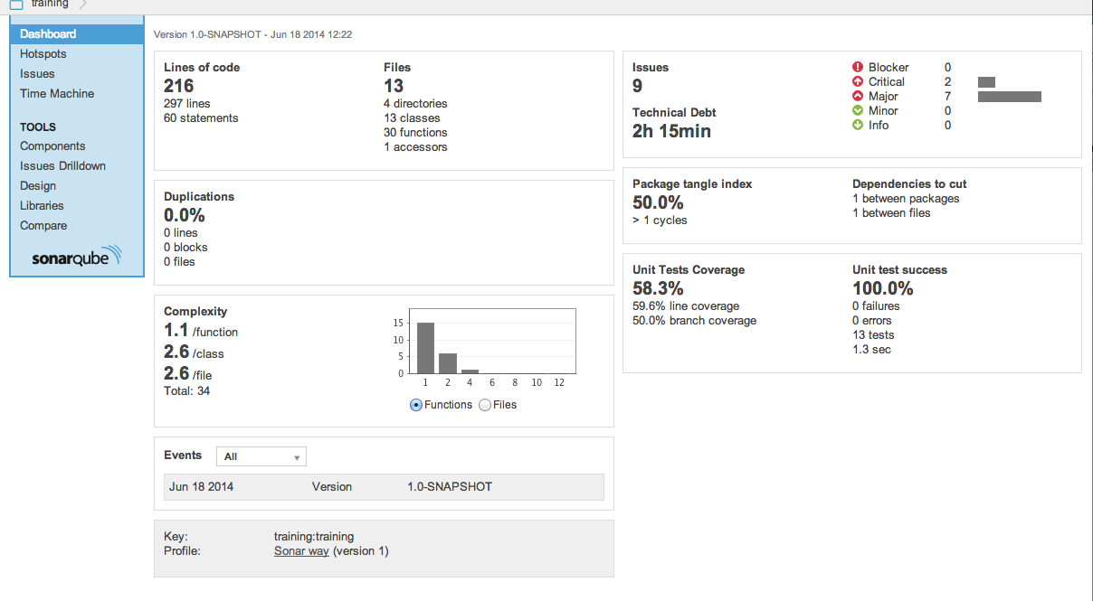
Sonarcube

Slide 4
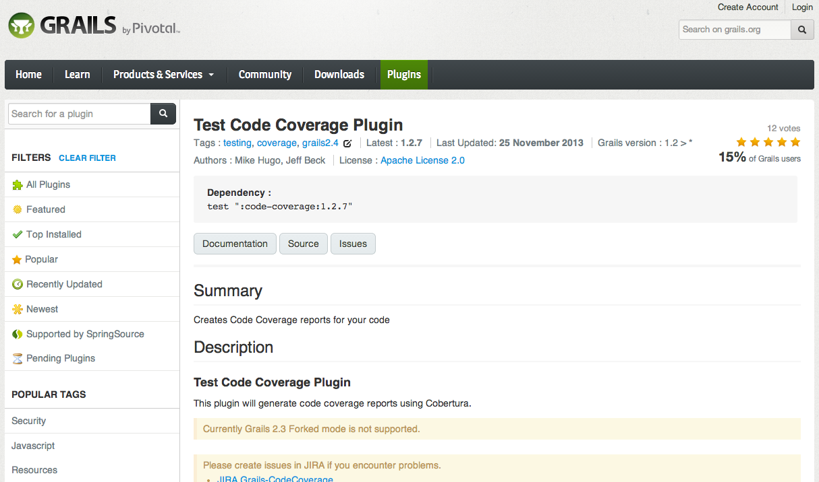
Test Coverage Plugin for Groovy

Slide 5
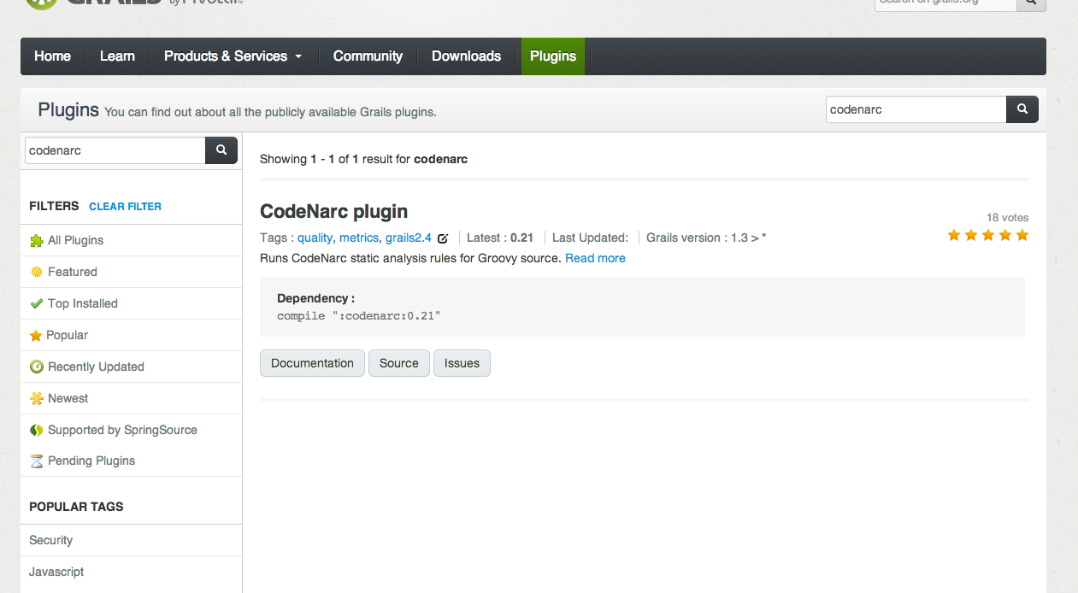
Codenarc

Slide 6
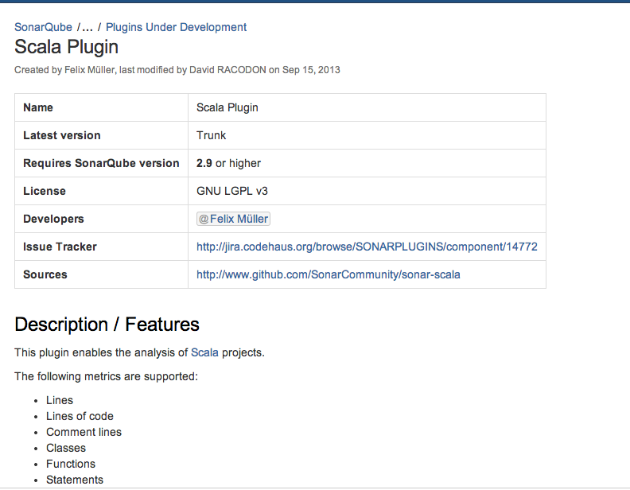
Scala Plugin

Slide 7

Post Star Wars

Slide 8
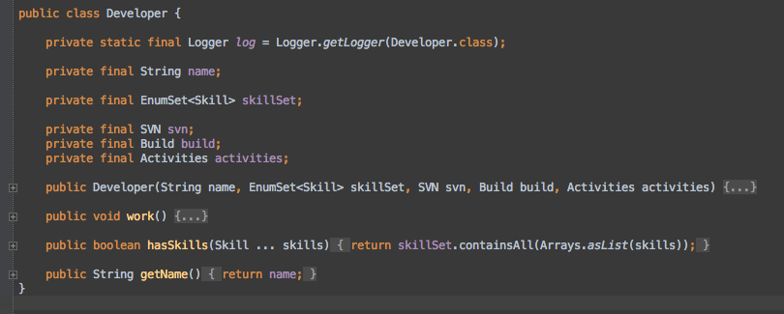
Developer

Slide 9
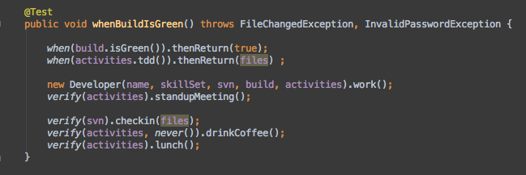
Test using Mokito

Slide 10
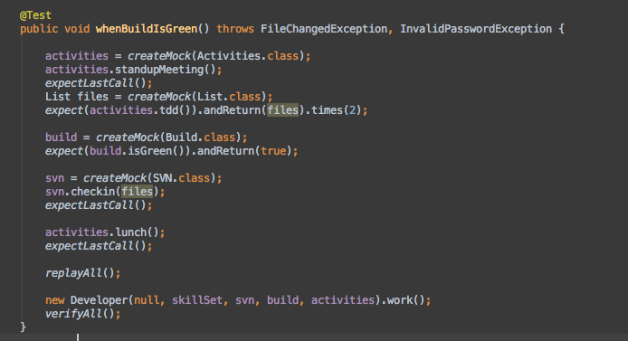
Test using PowerMock

Slide 11
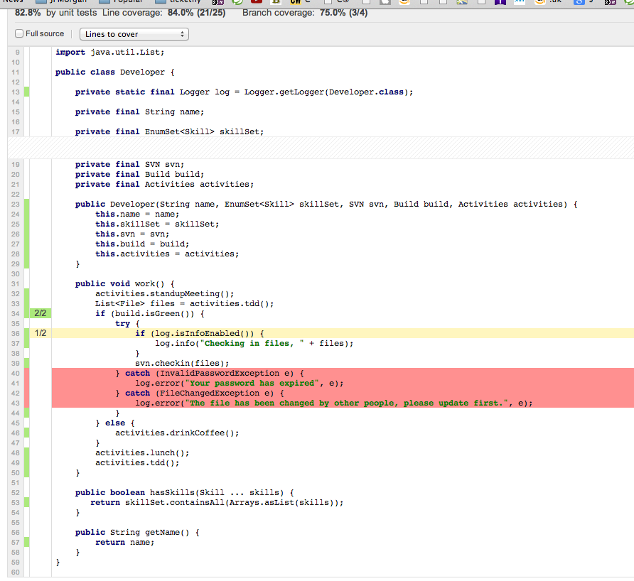

Slide 12
